Slide 1


Exploratory Data Analysis
emedcareers.com
by: ABDULLATIF ABDULLAH ALSABR
1

Slide 2
Index
SUBJECT | NUMBER
Summary Context | 3
Inspiration | 4
Problems | 5
Challenges | 6
columns | 7
Answer one | 8
Answer Two | 9
Answer Three | 10
Answer Four | 11
Conclusion | 12
Tools | 13
2

Slide 3
Summary Context
eMedCareers is a job search platform for pharmaceutical, biotechnology or healthcare jobs. This dataset contains 30000 latest job postings in Europe from eMedCareers job portal.
Data source:
Cilck Here
3

Slide 4
Inspiration
The uses of this dataset are endless. Some of the inspirations could be:
What is the site with the highest job opportunities?
What are the most searched jobs?
What is the ratio of different job types?
What is the largest number of job advertisements by a particular company?
4

Slide 5
Problems
Null
Missing
Duplicate
Data Clean
Some of them:
Null value
Missing data
Duplicate or unnecessary data
Inconsistent text and typos
Removing Whitespace
5

Slide 6
Challenges
All data was of type string
Extracting data and converting it from ordinary data to valuable data
Use the clearer graphics
Extracting valuable questions from the data
Choose the appropriate data
6

Slide 7
COLUMNS
Column name | Description | Type
Category | Required job name | String
Company Name | Companies looking for a pharmacist | String
Job description | Job description for the position being offered | String
Job title | Description of the job title | String
Job type | The type of job offered | String
Location | Position of the job | String
Posting date | Publication date for the proposed position | datetime64
Salary offered | Offer submitted for the position offered | String
7

Slide 8
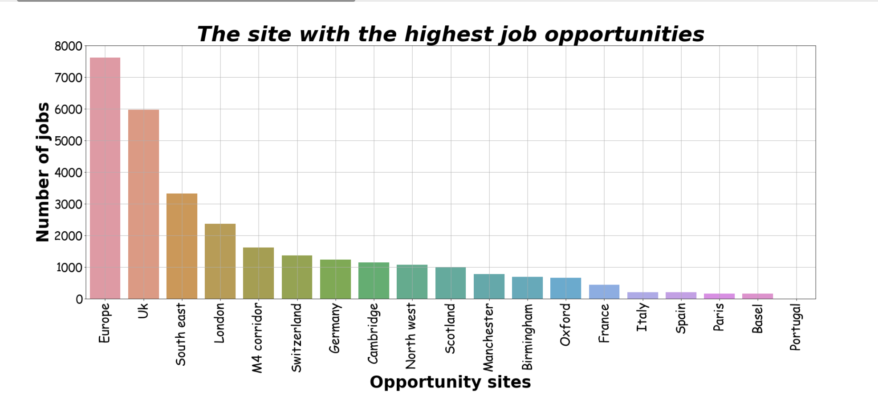
What is the site with the highest job opportunities?
8

Slide 9
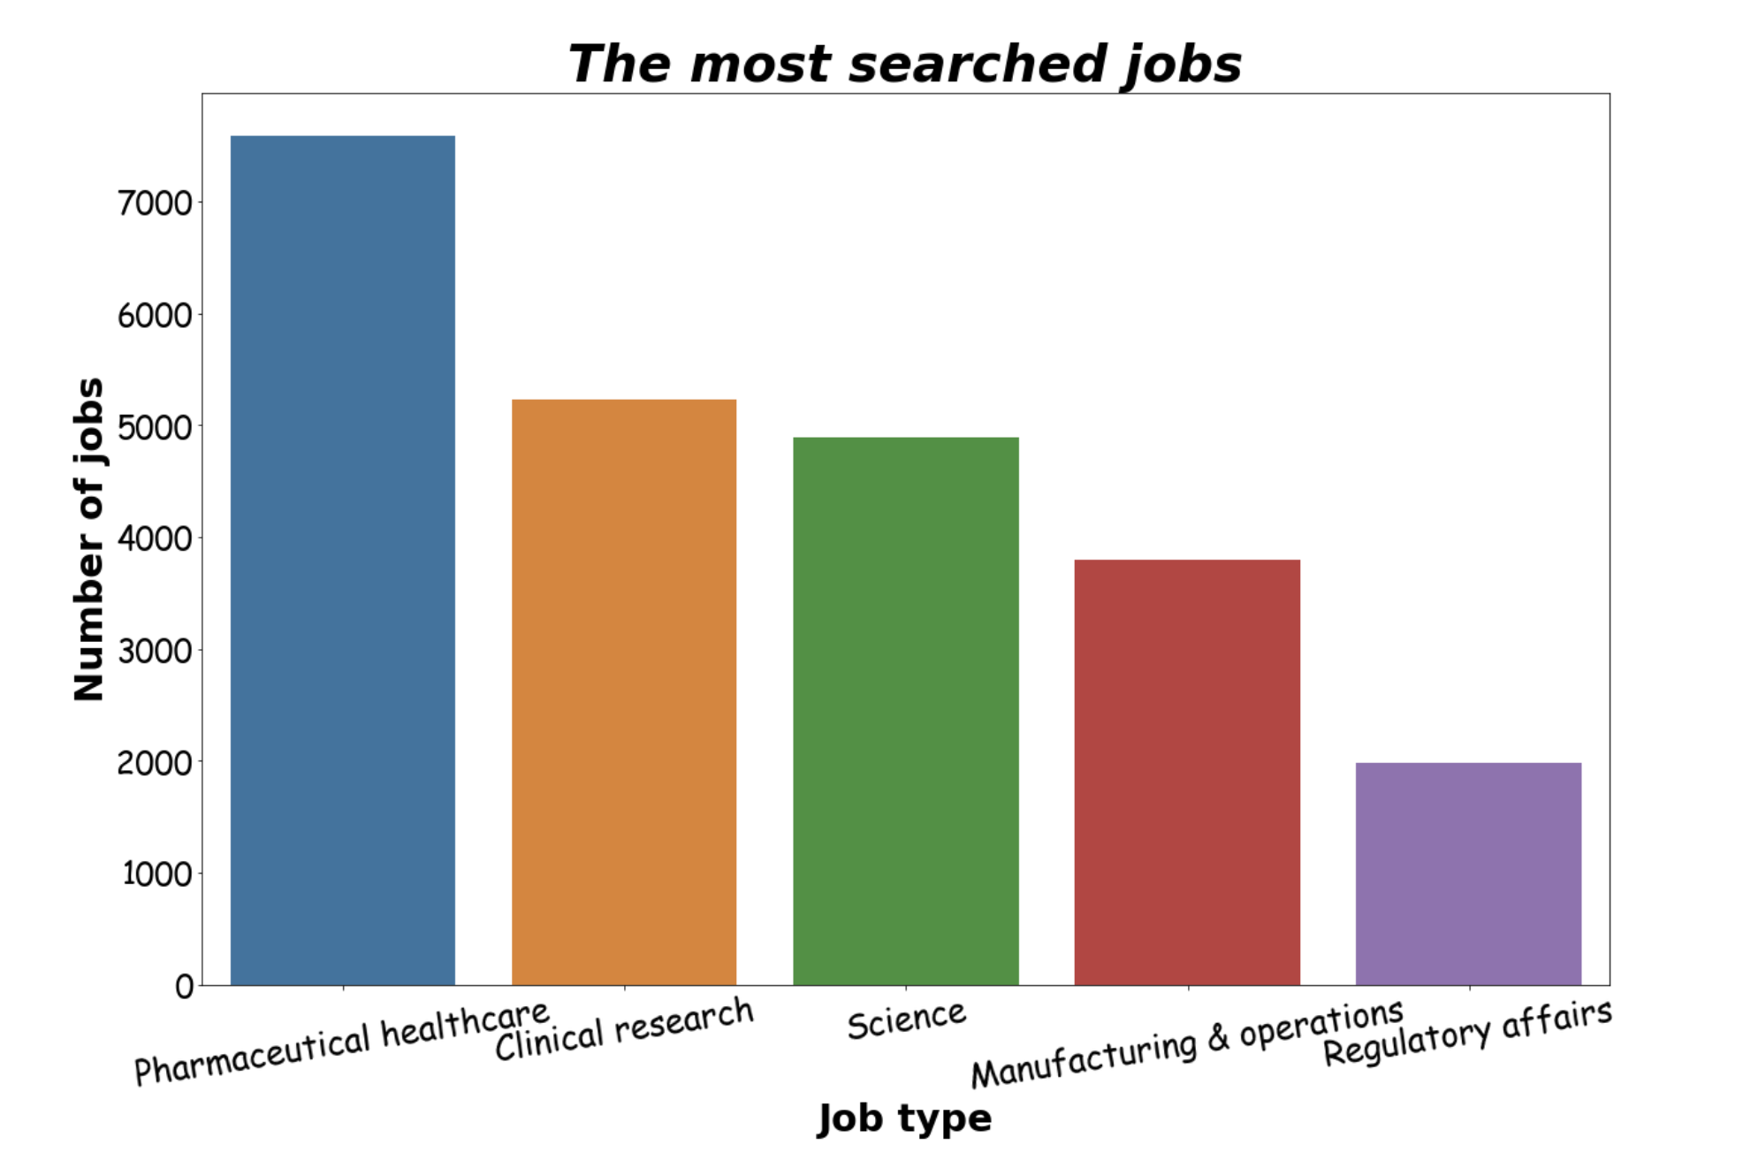
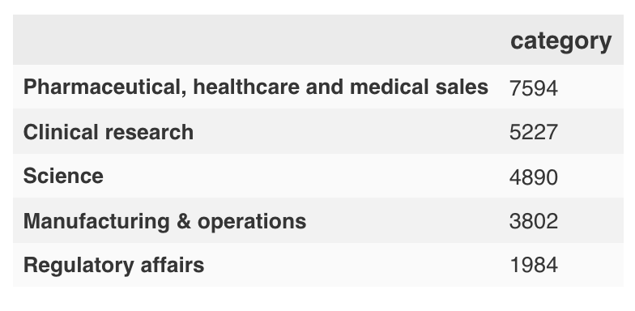
What are the most searched jobs?
9

Slide 10
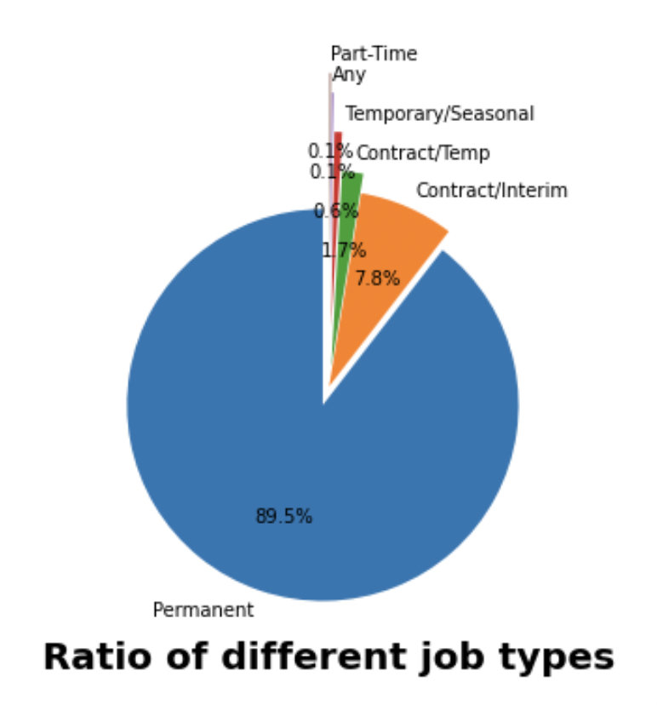
What is the ratio of different job types?
10

Slide 11
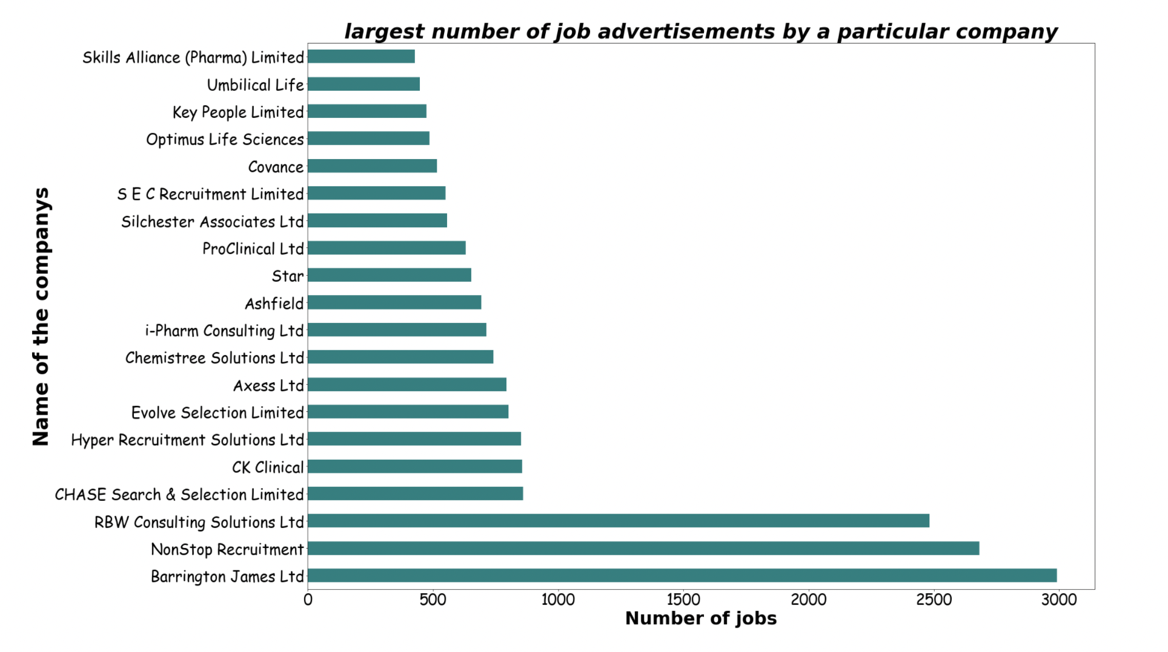
What is the largest number of job advertisements by a particular company?
11

Slide 12
Conclusion
It is possible, after looking at the data figures, that we can conclude that most of the jobs offered in Europe, as well as the types of jobs offered, i.e. permanent jobs, that the most company that offered jobs is a company Barrington James Ltd and that the most searched types of jobs are pharmaceutical healthcare
12

Slide 13
Tools
Tool
Jupyter notebook
NumPy
Pandas
Matplotlib
PowerPoint
seaborn
13

Slide 14
Thank you for attention!
Any question?
13

